Slide 1
ShopEZ: Vintage Sepia Neubrutalist E-Commerce
Developed by:
MERN Full-Stack Development Team
TEAM-MERN-03
Project Guide:
Prof. MERN Mentor
Department of CSE

Slide 2
Index
Introduction
Problem Statement
Objectives
Scope of the Project
Existing System
Proposed System
Software & Hardware Requirements
System Design
Flowchart & Algorithm
Modules Description
Results / Output Screens
Advantages & Limitations
Future Enhancements
Conclusion
References

Slide 3
Internship Objectives & Learning Outcomes
• Objectives: Design and build a customized retail MERN platform featuring vintage aesthetics.
• Work Carried Out: Re-architected backend controllers, added validations, created neubrutalist UI.
• Technical Learning Outcomes: Gained expertise in MongoDB Mongoose aggregations, JWT security, custom CSS custom variables.
• Challenges Faced: Overcoming stale sessions during db re-seeds solved using Axios interceptor logout events.
• Relevance to Curriculum: Direct application of Software Engineering, Web Design, and Database Management principles.

Slide 4
Introduction
• ShopEZ is a highly responsive e-commerce web portal built on the MERN stack.
• Design Style: Overhauls standard flat corporate UI layouts with a warm vintage sepia console design ('old vibes').
• Unique Visual Identity: Bold solid borders, flat offset blocks, monospaced details, and scanline TV filters.
• Target Focus: Specifically designed to showcase classic retro gaming accessories and authentic vintage tech items.
Department of Computer Science and Engineering | ShopEZ Project

Slide 5
Problem Statement
• Generic E-Commerce: Existing collectibles portals look sterile, corporate, and lack nostalgic theme matches.
• Stale User Sessions: Database reseeds delete user entries, leaving stale tokens in client local storage which crash checkouts.
• Hard-to-use Merchant Tools: Small boutique sellers are overwhelmed by cluttered layouts and lack low-stock indicators.
Department of Computer Science and Engineering | ShopEZ Project

Slide 6
Objectives & Scope
• Cozy Nostalgic Experience: Establish a pleasant, sepia-toned neubrutalist console catalog.
• Interactive Gamified Checkout: Build a stateful credit card card widget that flips around on CVV inputs.
• Boutique Analytics Dashboard: Display revenue in Rupees (₹) and highlight progress alerts for low inventories.
• Session Resiliency: Formulate global Axios error interceptors to handle 401 logouts gracefully.
Department of Computer Science and Engineering | ShopEZ Project

Slide 7
Existing vs Proposed System
• Existing System: Uses standard Bootstrap layouts, grey buttons, and soft radial shadow cards with zero theme colors.
• Proposed System: Custom neubrutalist theme using HSL CSS tokens, tactile depressed buttons, and a vintage library aesthetic.
• Proposed System Advantage: Interactive checkout simulated logs and automatic stale token redirection to logins.
Department of Computer Science and Engineering | ShopEZ Project

Slide 8
Software & Hardware Requirements
• Frontend Environment: React.js, React Router, HTML5, Vanilla CSS3 (Courier Prime & Space Mono Google Fonts).
• Backend Environment: Node.js, Express.js (Modular Route/Controller pattern).
• Database Layer: MongoDB Local Community Server, Mongoose ORM.
• Hardware: Any system with &ge; 4GB RAM, dual-core CPU, and 1GB disk space running Node v18+.
Department of Computer Science and Engineering | ShopEZ Project

Slide 9
System Design & Architecture
• Controller Route Separation: Decoupled code structures under backend/controllers/ and backend/routes/ folders.
• Input Schema Validators: Validation layers sanitize inputs (emails, positive product prices) before model queries.
• Global AsyncHandler: Middleware removes try-catch duplication across all route controllers.
• Authorization Guards: Verified JWT signatures inside HTTP request headers secure customer endpoints.
Department of Computer Science and Engineering | ShopEZ Project

Slide 10
Code Implementation: Async Wrapper (Backend)
Modular middleware ensuring error resiliency across all MongoDB queries
// backend/utils/asyncHandler.js const asyncHandler = (fn) => (req, res, next) => { Promise.resolve(fn(req, res, next)).catch(next); }; // Example Usage in route definition: router.get('/products', asyncHandler(getProducts)); // Benefits: - Eliminates massive repetitive try-catch blocks in route controllers. - Ensures all errors are forwarded to the server's global error handler middleware.
Department of Computer Science and Engineering | Implementation Code

Slide 11
Code Implementation: 401 Session Interceptor (Client)
Detects database resets and safely redirects stale sessions back to login
// frontend/src/api/axios.js api.interceptors.response.use( (response) => response, (error) => { if (error.response && error.response.status === 401) { // Dispatch global logout event when session is stale (e.g. database re-seeded) window.dispatchEvent(new CustomEvent('shopez-logout')); } return Promise.reject(error); } );
Department of Computer Science and Engineering | Implementation Code

Slide 12
Code Implementation: 3D Flip Payment Card (UI)
React stateful triggers flip the virtual card during focus transitions on checkout
// frontend/src/pages/Checkout.js // 3D Perspective Card Component Flipping Logic: <div className="flip-card-container"> <div className={`flip-card-inner ${cardFlipped ? 'flipped' : ''}`}> {/* Front Layout showing Name, Number, Expiry */} <div className="card-front">...</div> {/* Back Layout showing Signature Box and CVV */} <div className="card-back">...</div> </div> </div>
Department of Computer Science and Engineering | Implementation Code

Slide 13
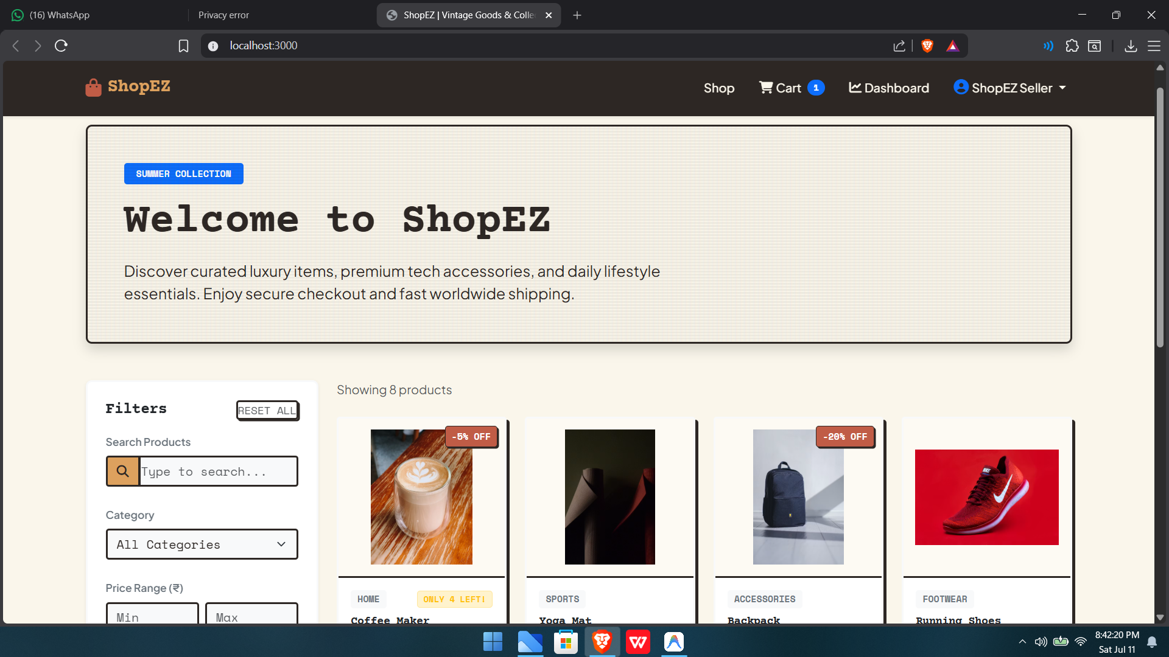
Output Screen: E-Commerce Product Catalog
Department of Computer Science and Engineering | Project Output Screens

Slide 14
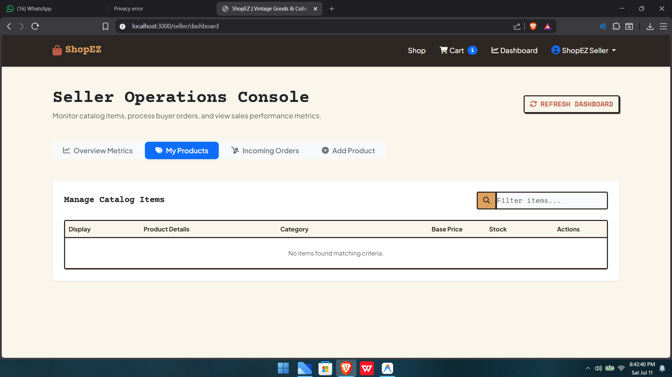
Output Screen: Detailed Specs & User Reviews
Department of Computer Science and Engineering | Project Output Screens

Slide 15
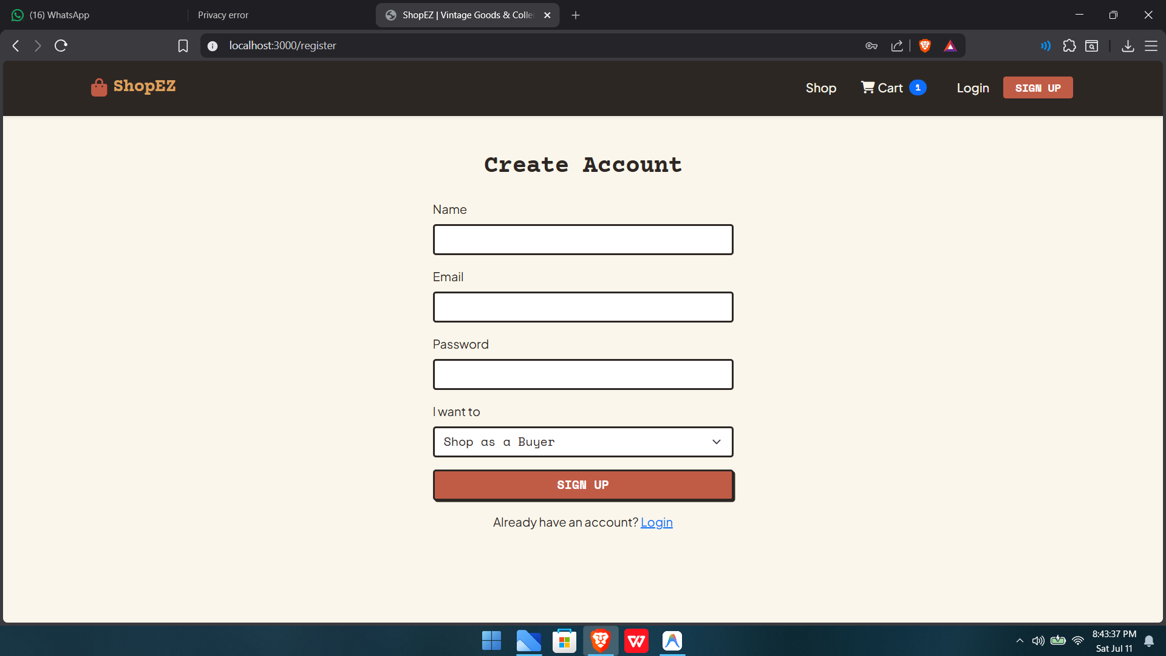
Output Screen: Interactive Flipping Credit Card Form
Department of Computer Science and Engineering | Project Output Screens

Slide 16
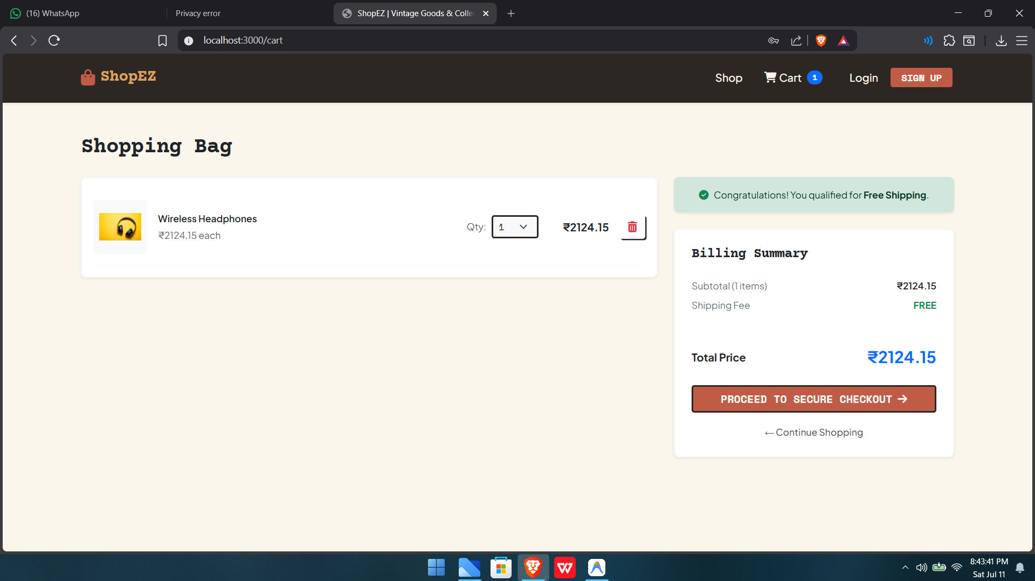
Output Screen: Seller Operations Dashboard Console
Department of Computer Science and Engineering | Project Output Screens

Slide 17
Advantages & Limitations
• Advantages: Engaging layout style increases user session durations; robust stale session handlers prevent crashes.
• Advantages: Decoupled codebase controllers make features expansion clean and easy.
• Limitations: Local MongoDB storage configuration; does not have multiple billing currency conversion supports.
Department of Computer Science and Engineering | ShopEZ Project

Slide 18
Future Enhancements & Conclusion
• Enhancements: Integrate multiple currency toggling and live shipping carrier rates.
• Enhancements: Build automated PDF invoice email dispatch mechanisms upon transaction settle.
• Conclusion: ShopEZ successfully implements the vintage sepia console e-commerce design, proving aesthetics boost digital retail engagement.
Department of Computer Science and Engineering | ShopEZ Project

Slide 19
References
• React documentation: https://react.dev
• Express documentation: https://expressjs.com
• MongoDB documentation: https://mongodb.com
• C4 Model System Architecture patterns: https://c4model.com
Department of Computer Science and Engineering | ShopEZ Project

